Slide 1


Slide 2


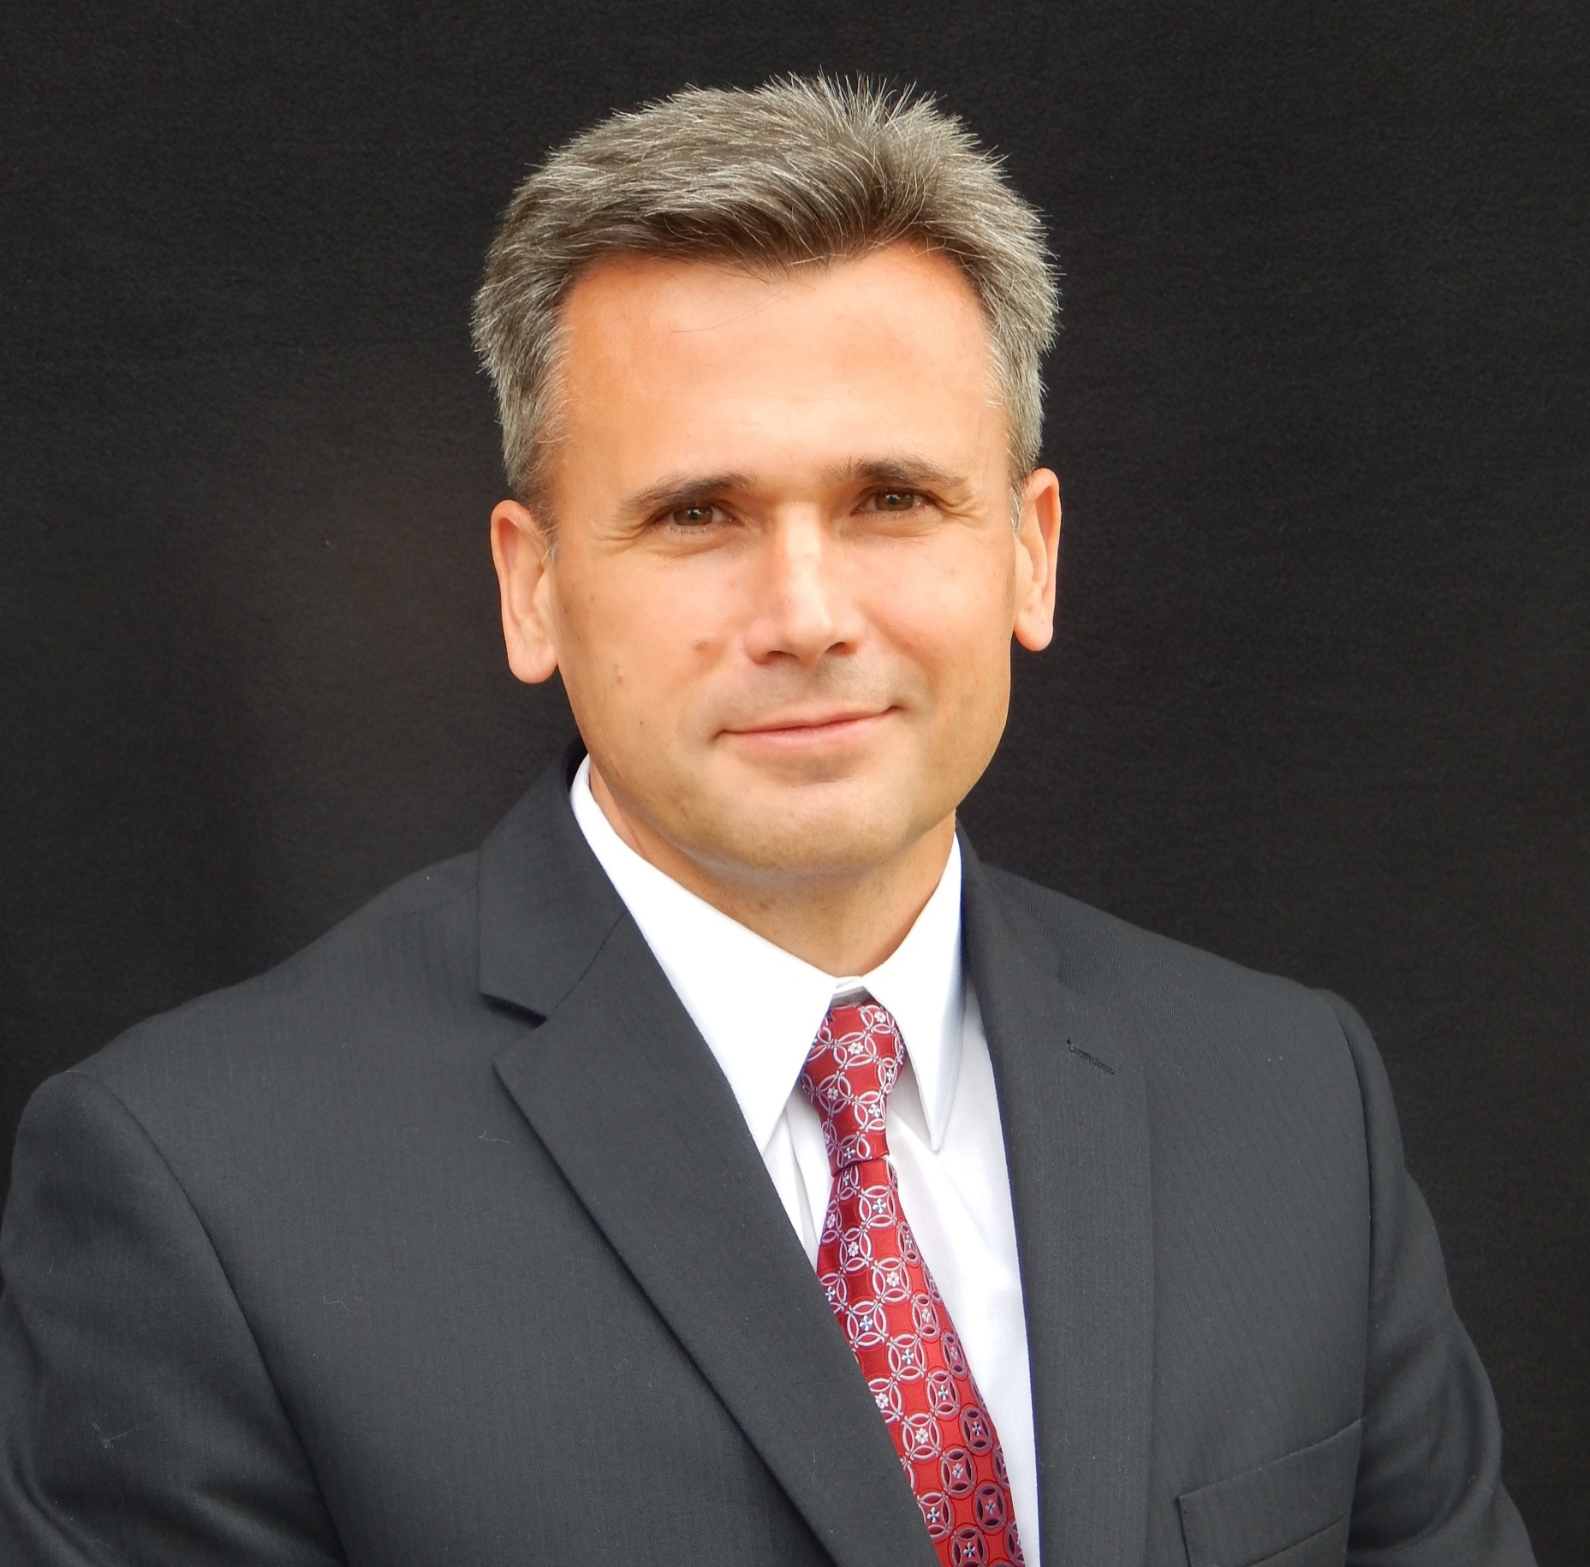





Elizabeth Rula, Ph.D.
Executive Director of the Harvey L. Neiman Health Policy Institute
Eric Christensen, Ph.D.
Research Director
YoonKyung Chung, Ph.D.
Principal Economic and Health Services Researcher
Mikki Waid, Ph.D.
Principal Economic and Health Services Researcher
Casey Pelzl, MPH
Principal Economic and Health Services Researcher
Alexandra Drake, MPH
Senior Economic and Health Services Researcher

Slide 3
Discussion Topics
HPI Overview (Elizabeth Rula)
The Future of the Radiology Workforce and Imaging Demand (Eric Christensen and Casey Pelzl)
The Impact of Radiology on Population Health (Casey Pelzl and Allie Drake)
How Radiology Fits Into Value Based Payment Models (Yoonie Chung)
Interventional Radiology Research (Mikki Waid)

Slide 4


Slide 5
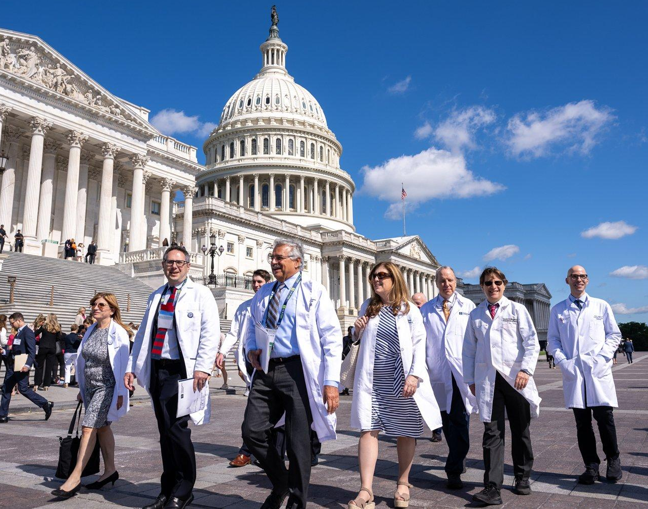

Influencing Workforce, Screening, and Access Policy
Workforce Planning and Imaging Demand
  HPI models radiologist supply and imaging demand to identify workforce shortages impacting timely diagnosis and access.
Increasing Population Health via Cancer Screening Policy
  Lung Cancer Screening: HPI research shows shared decision-making improves long-term lung cancer screening adherence among high-risk patients.
  Breast Cancer Screening: HPI analysis of coverage laws reveals expanded benefits increase uptake of advanced breast screening modalities and improve equitable access.
Scope-of-Practice / Non-Physician Providers
  HPI evaluation of scope-of-practice expansion has indicated that non-physicians as ordering or interpreting providers are associated with the imaging overuse.
Notes:
HPI’s work has played a role in shaping policy and practice across a wide range of topics. Here are examples of key topics within our portfolio.
Currently there is a workforce shortage in radiology that is a priority concern for ACR members, and we know that the challenges are experienced by other medical specialties as well. We have a large body of work aimed at understanding the supply side and demand side drivers of this shortage, and what it means for patients. What we are finding is that the primary issue is growth in imaging, often overused or unnecessary imaging, that is creating a cycle of unsustainable volume that is associated with higher turnover and attrition rates.
EXAMPLE: turnaround time paper this week
Cancer imaging is a consistent priority for our research.

Slide 6

Award-Winning Research and National Recognition
  2025 AuntMinnie Minnies Award — Eric Christensen, PhD: Most Influential Radiology Researcher
  Neiman Institute Research Earns Top Honors in Leading Radiology Journals
  AJR Best of 2025 — Policy, Quality & Practice Management: Self‑Interpretation of Imaging Studies by Ordering Providers
  JACR Best of 2025 — Health Services Research & Policy: Office‑Based Diagnostic Imaging Interpreted by Nonphysician Practitioners
  JACR Best of 2025 — Training & Education: Evolving Trainee Participation in Radiologists’ Workload (Medicare 2008–2020)

Slide 7





HPI Research Policy Impact
Recent policy change AND HPI research used for advocacy:
New policy
Medicare coverage for CT colonography screening, 2025
HPI: Medicare patients in high-income areas are receive CTC at 5.7 the rate of those in low-income areas
H.R.2474 - Strengthening Medicare for Patients and Providers Act
HPI: Radiologist payments per FFS
patient declined 25% over 16 years w/
inflation while billing 13% more RVUs
Research
Christensen et al, 2024
Kao et al., 2025; Christensen et al, 2023
No Surprises Act Court Wins TMA I-IV & 2024 Appeals Court
HPI: Physicians lose money when challenging insurer payments via IDR
Only 1% of radiology claims OON
NSA may decrease in-network payments
CMS MIPS scoring to flat rate benchmark in 2025
HPI: Radiologists in radiology-only
practices score lower in MIPS; those
in multispecialty practices score higher by reporting other-specialty measures
Rad Oncology Case Rate (ROCR) Value-Based Program Act of 2024
HPI: Proposed Radiation Oncology Bundled Payments Produce Medicare Savings with Goal of Stabilizing Reimbursement
Christensen et al, 2024;
Heller et al, 2021; Parikh et al,2024;
Chung et al, 2024, 2025, and 2026
Bush et al, 2024
Notes:
HPI publications and evidence is critical to ensuring patient access to radiology services. Here are examples of active or recent policy change, with a key finding from recent HPI research studies that informed that policy through advocacy. You can see that these represent important issues for ACR members:
Reimbursement for CT Colonography screening
Physician reimbursement
No Surprises Act
Value –based payments in MIPS
RO alternative payment model
References
CTC equity study:
Christensen EW, Sanelli PC, Rula EY, Chang KJ, Moreno CC, Bruining DH, Yee J. Sociodemographic Factors and Screening CT Colonography Use Among Medicare Beneficiaries. AJR Am J Roentgenol. 2024 Jan;222(1):e2329703.
Kao SZ, Sanmartin MX, Yee J, Chang KJ, Moreno CA, Brewington C, Bruining DH, Christensen EW, Rula EY, Sanelli PC. Cost-Effectiveness of CT Colonography Under Real-World Colorectal Cancer Screening Adherence for Black and White Populations. Cancer Med. 2025 Nov;14(21):e71290. doi: 10.1002/cam4.71290
Strengthening Medicare (reimbursement):
Christensen EW, Nicola GN, Rula EY, Nicola LP, Hirsch JA. Medicare Volume Growth and Shift in Payments From Physicians to Non-Physician Practitioners Under Statutory Budget Neutrality. INQUIRY: The Journal of Health Care Organization, Provision, and Financing. 2024;61. doi:10.1177/00469580241249076
Christensen EW, Nicola GN, Rula EY, Nicola LP, Hemingway J, Hirsch JA. Budget Neutrality and Medicare Physician Fee Schedule Reimbursement Trends for Radiologists, 2005 to 2021. J Am Coll Radiol. 2023 Oct;20(10):947-953. doi: 10.1016/j.jacr.2023.07.009.
No surprises act studies:
Parikh JR, Drake AR, Waid MD, Rula EY, Christensen EW. Radiologists' Out-of-Network Billing Trends, 2007 to 2021. J Am Coll Radiol. 2024 Jun;21(6):851-857. doi: 10.1016/j.jacr.2023.11.015.
Christensen EW, Waid MD, Hirsch JA, Parikh JR, Raja AS, Rathmell JP, Rula EY. Financial Viability of the No Surprises Act Independent Dispute Resolution Process: Radiology and Other Hospital-Based Specialties. AJR Am J Roentgenol. 2024 Apr;222(4):e2330687. doi: 10.2214/AJR.23.30687.
Heller RE 3rd, Gaines E, Parti N, Duszak R Jr. Federal Out-of-Network Balance Billing Legislation: Context and Implications for Radiology Practices. Radiology. 2021 Sep;300(3):506-511. doi: 10.1148/radiol.2021210491.
MIPS study:
Chung Y, Nicola LP, Liu CM, Rula EY. Radiologists' 2021 Quality Reporting and Performance in Medicare's Merit-Based Incentive Payment System: Analysis by Practice Type. AJR Am J Roentgenol. 2024 Jun;222(6):e2330809. doi: 10.2214/AJR.23.30809.
Chung Y, Liu CM, Nicola LP, Rula EY. Factors Influencing Radiologist Performance in the Merit-Based Incentive Payment System. J Am Coll Radiol. 2025 May;22(5):561-572. doi: 10.1016/j.jacr.2025.01.011
ROCR study:
Bush A, Liu CM, Rula EY, Luh J, Yu NY, Laack N, Attia A, Waddle M. Caught Between a Radiation Oncology Case Rate (ROCR) and a Hard Place: Improving Proposed Radiation Oncology Alternative Payment Models. Int J Radiat Oncol Biol Phys. 2024 Jul 9:S0360-3016(24)02585-9. doi: 10.1016/j.ijrobp.2024.06.034.

Slide 8


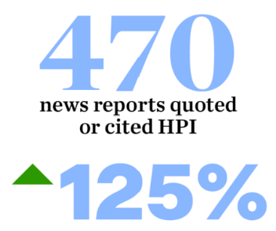
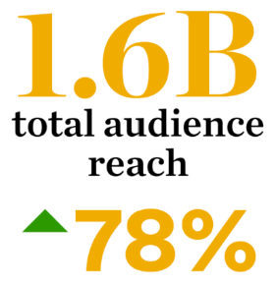
Raising Awareness:
Evidence Supporting the ACR Member Interests
The HPI Achieved its Best-Ever Earned-Media in 2025
Keep up on our website: www.neimanhpi.org
Major Media Outlets:
New York Times
Forbes
USA Today
HealthDay
US News & World Report Becker’s Hospital Review

Slide 9
The Future of the Radiology Workforce and Imaging Demand
Eric Christensen and Casey Pelzl

Slide 10
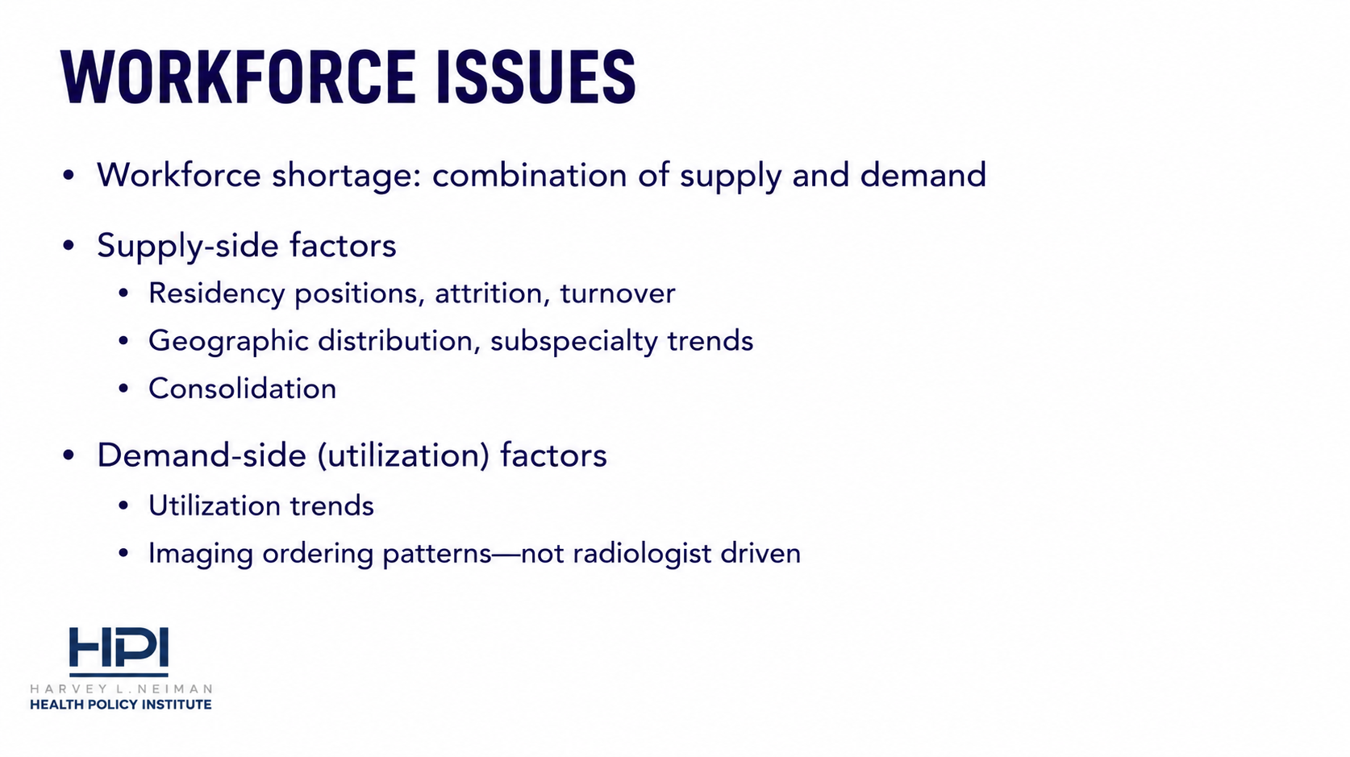

Slide 11
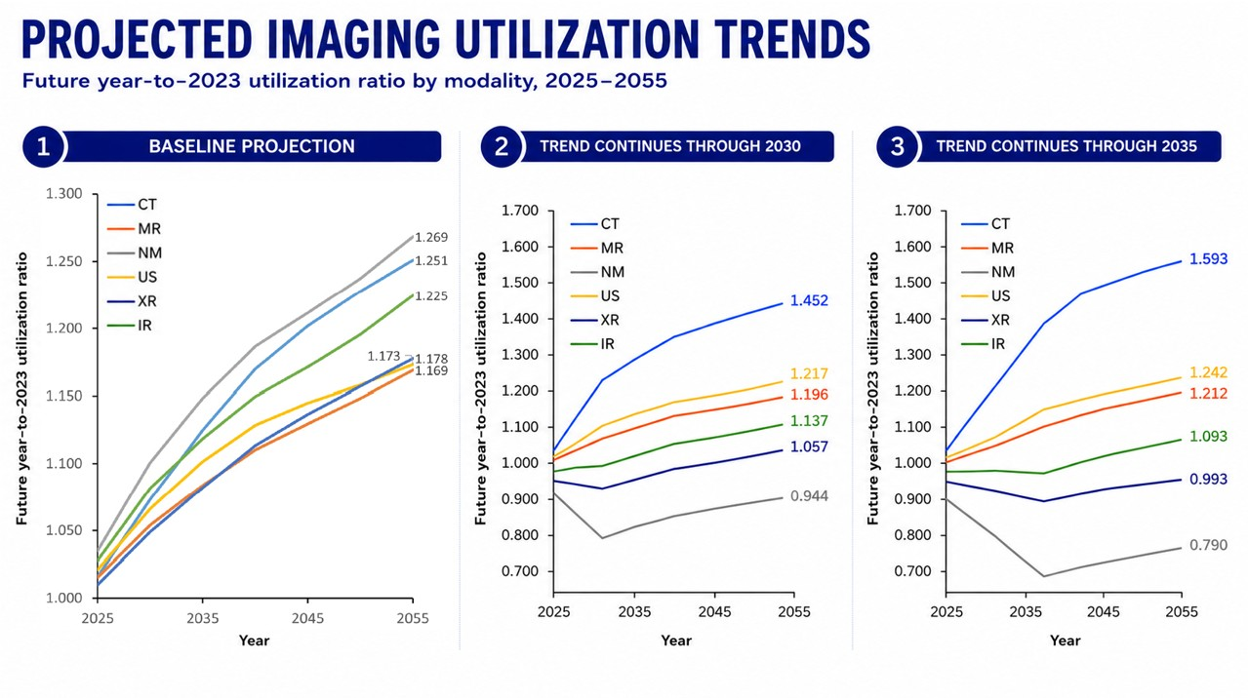
Source: Projected US Imaging Utilization, 2025 to 2055. Christensen et al. J Am Coll Radiology 2025; 22(2):151-158.

Slide 12
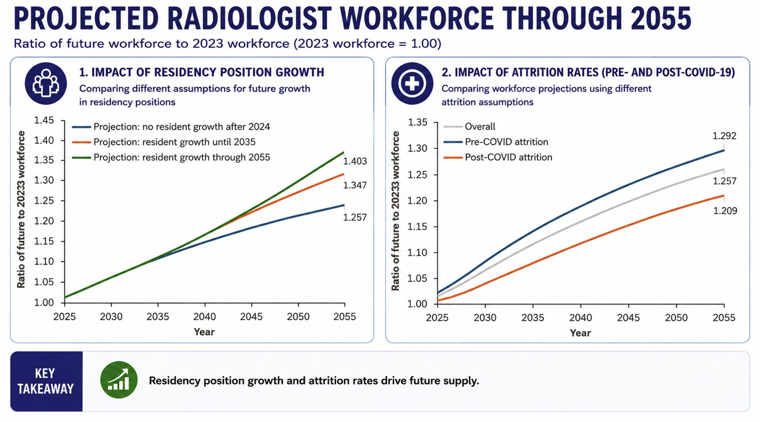
Source: Projected US Radiology Supply, 2025 to 2055. Christensen et al. J Am Coll Radiology 2025; 22(2):161-169.

Slide 13
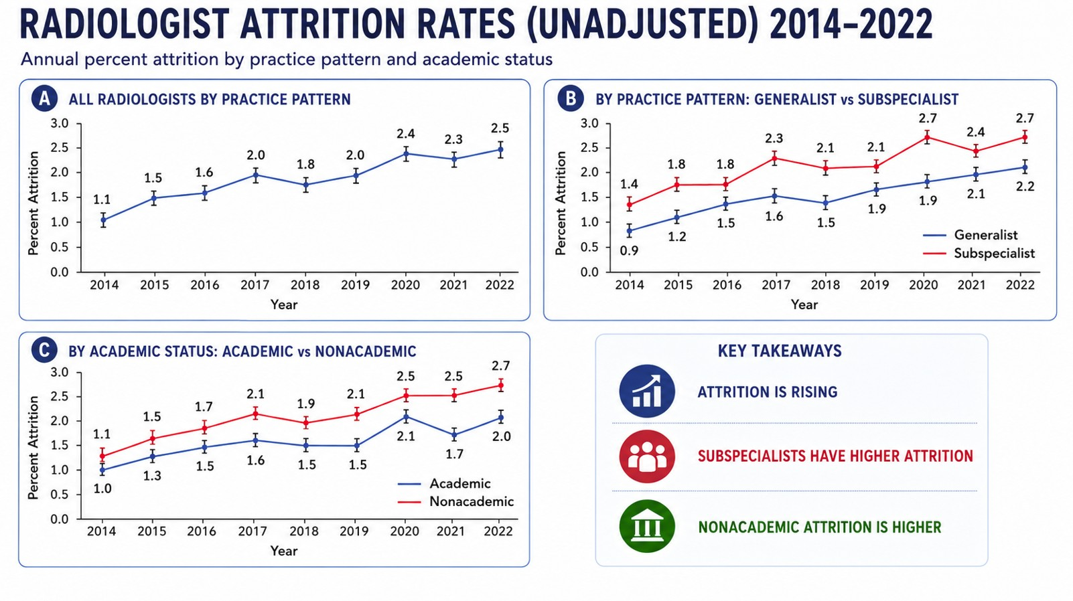
Sources: (1) Attrition of the National Radiologist Workforce: Associations With Radiologist and Practice Characteristics. Christensen et al. AJR 2026; 226(1):e2533587 and (2) Increasing—Yet Varying—Radiologist Workforce Attrition Across Subspecialties. Christensen et al. AJR 2026.

Slide 14
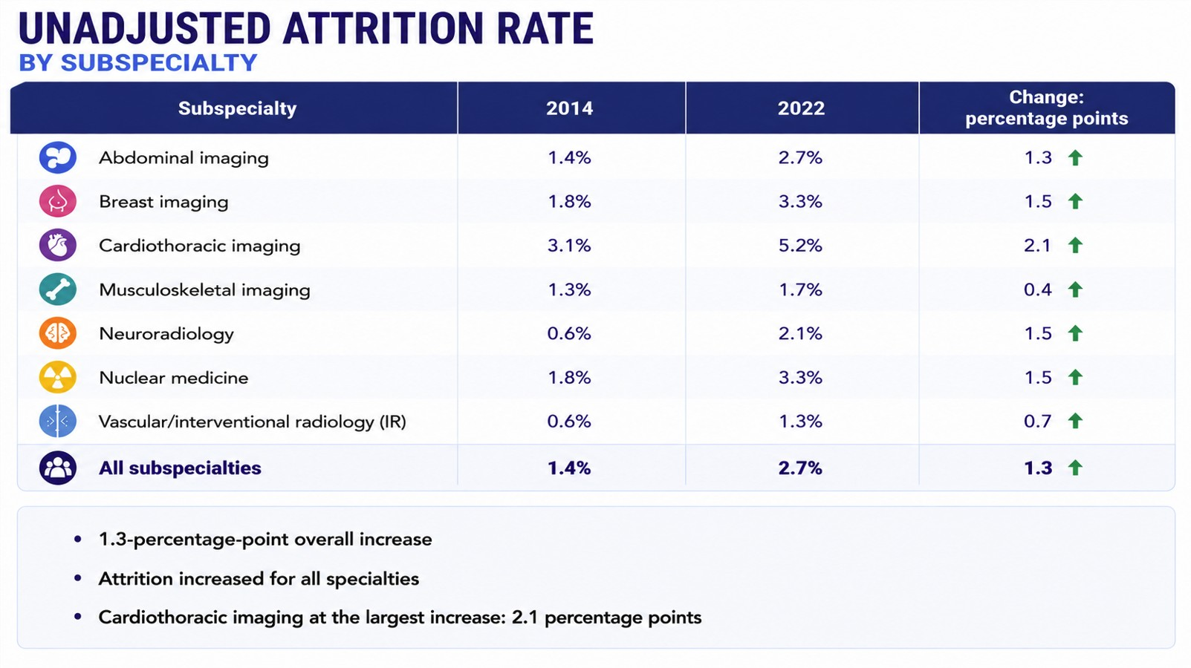
Source: Increasing—Yet Varying—Radiologist Workforce Attrition Across Subspecialties. Christensen et al. AJR 2026.

Slide 15
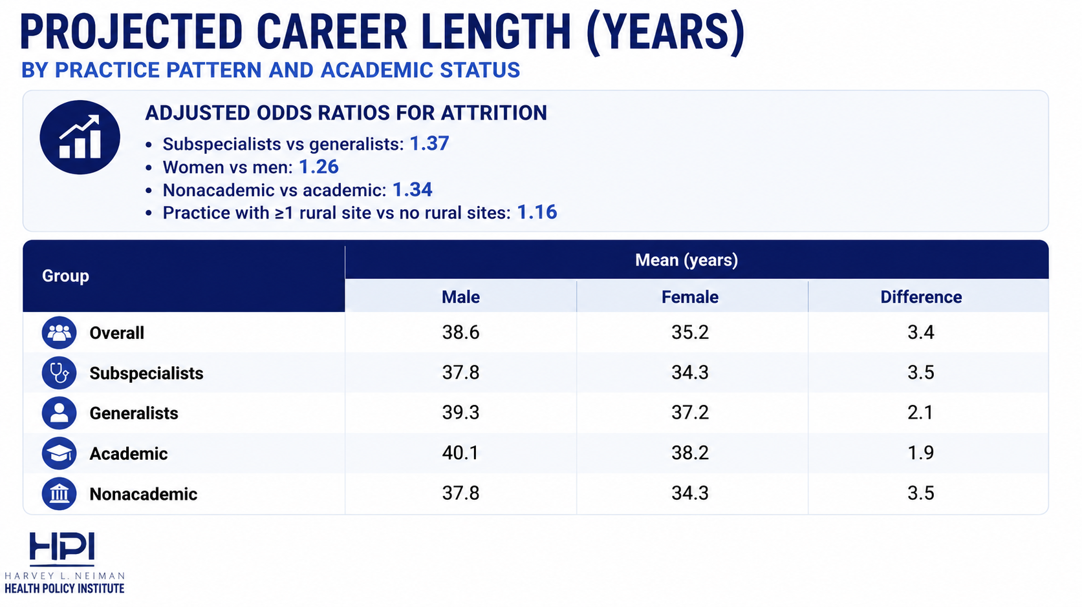
Source: Attrition of the National Radiologist Workforce: Associations With Radiologist and Practice Characteristics. Christensen et al. AJR 2026.

Slide 16
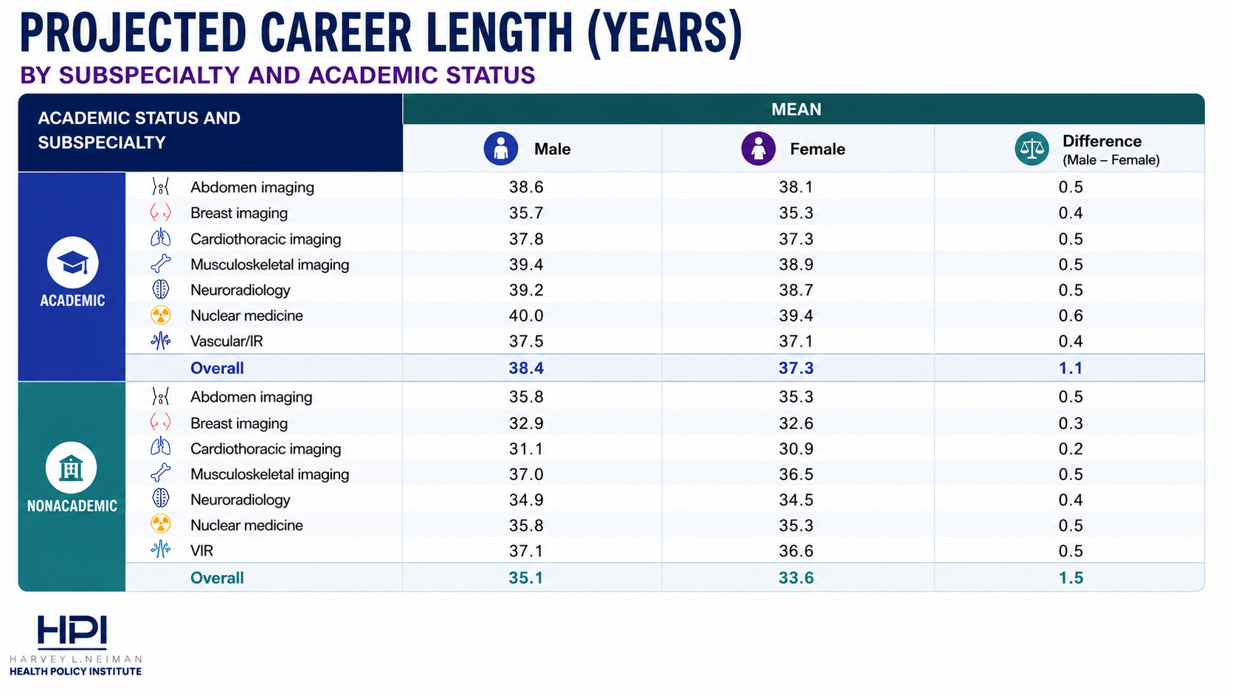
Source: Increasing—Yet Varying—Radiologist Workforce Attrition Across Subspecialties. Christensen et al. AJR 2026.

Slide 17
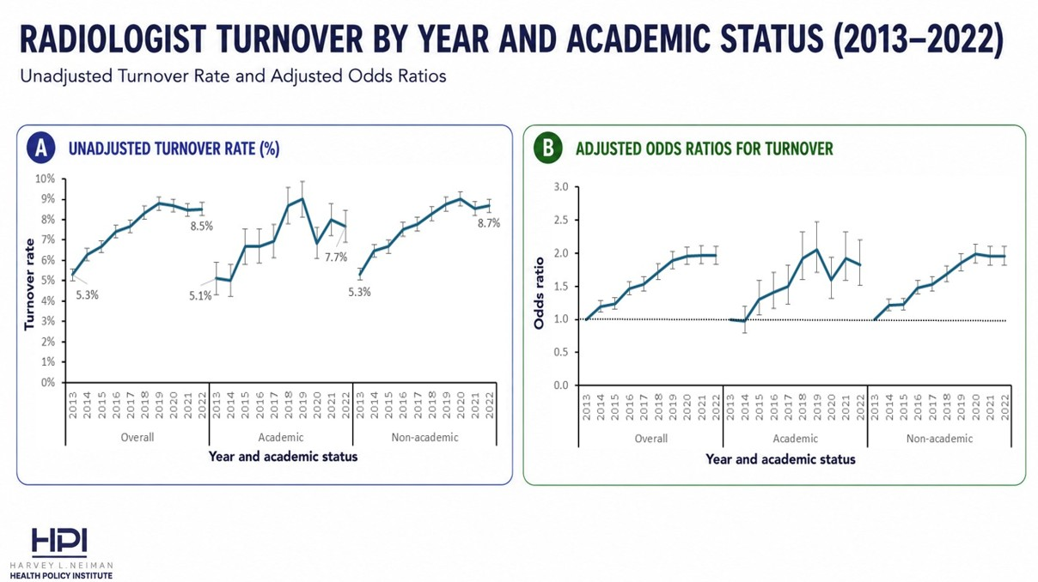
Source: Radiologist Turnover in the United States. Parikh et al. JACR 2026; 23(6):1058-1066.

Slide 18
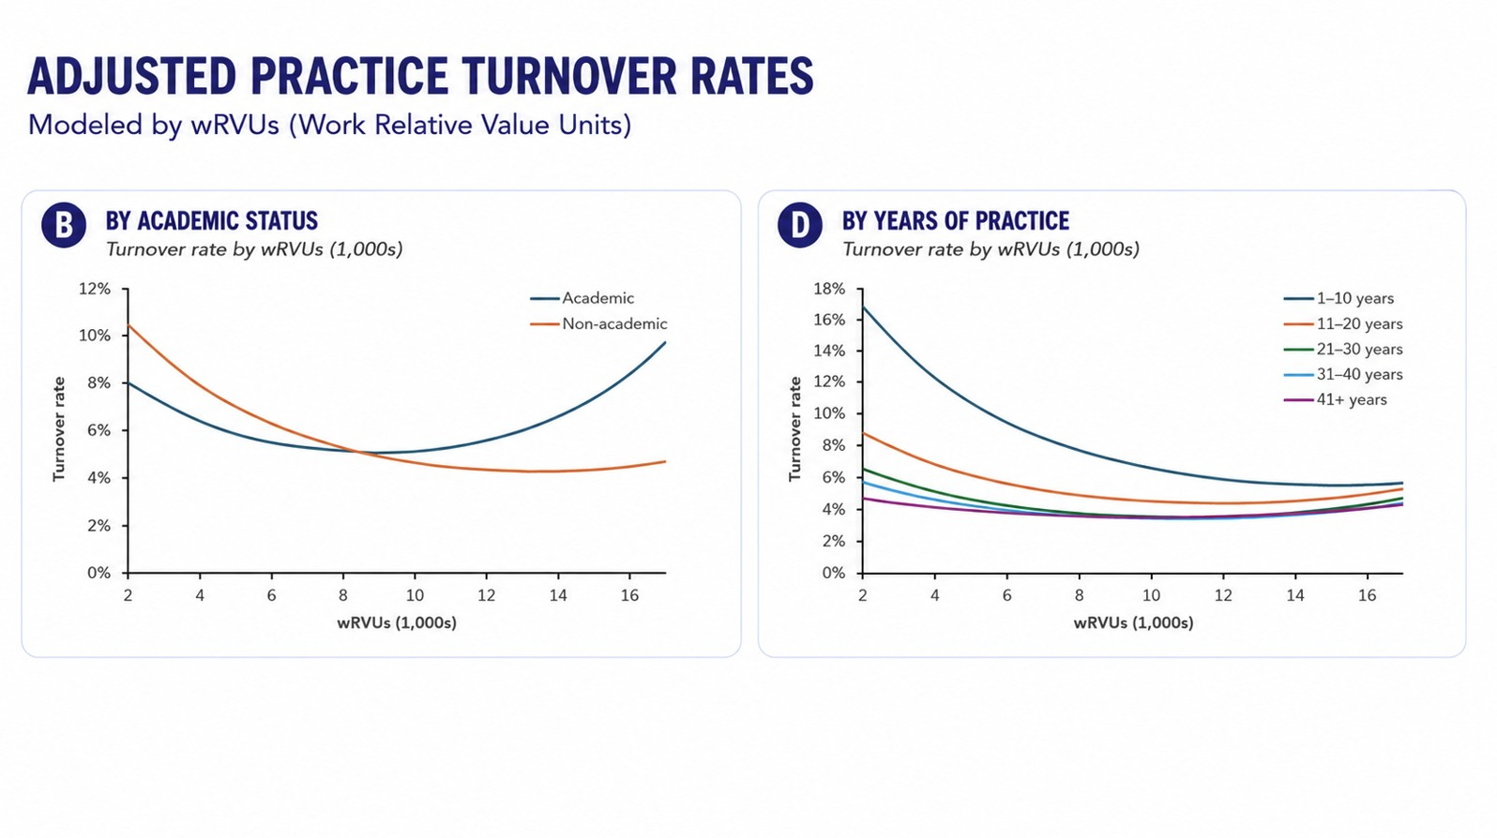
Source: Radiologist Turnover in the United States. Parikh et al. JACR 2026; 23(6):1058-1066.

Slide 19
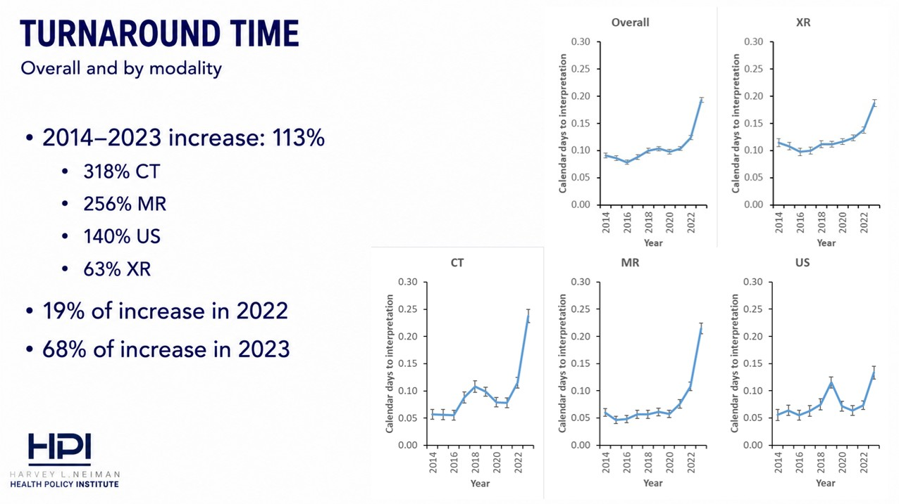
Source: National Turnaround Time Trends for Medicare Fee-For-Service Beneficiaries. Christensen et al. JACR 2026.

Slide 20
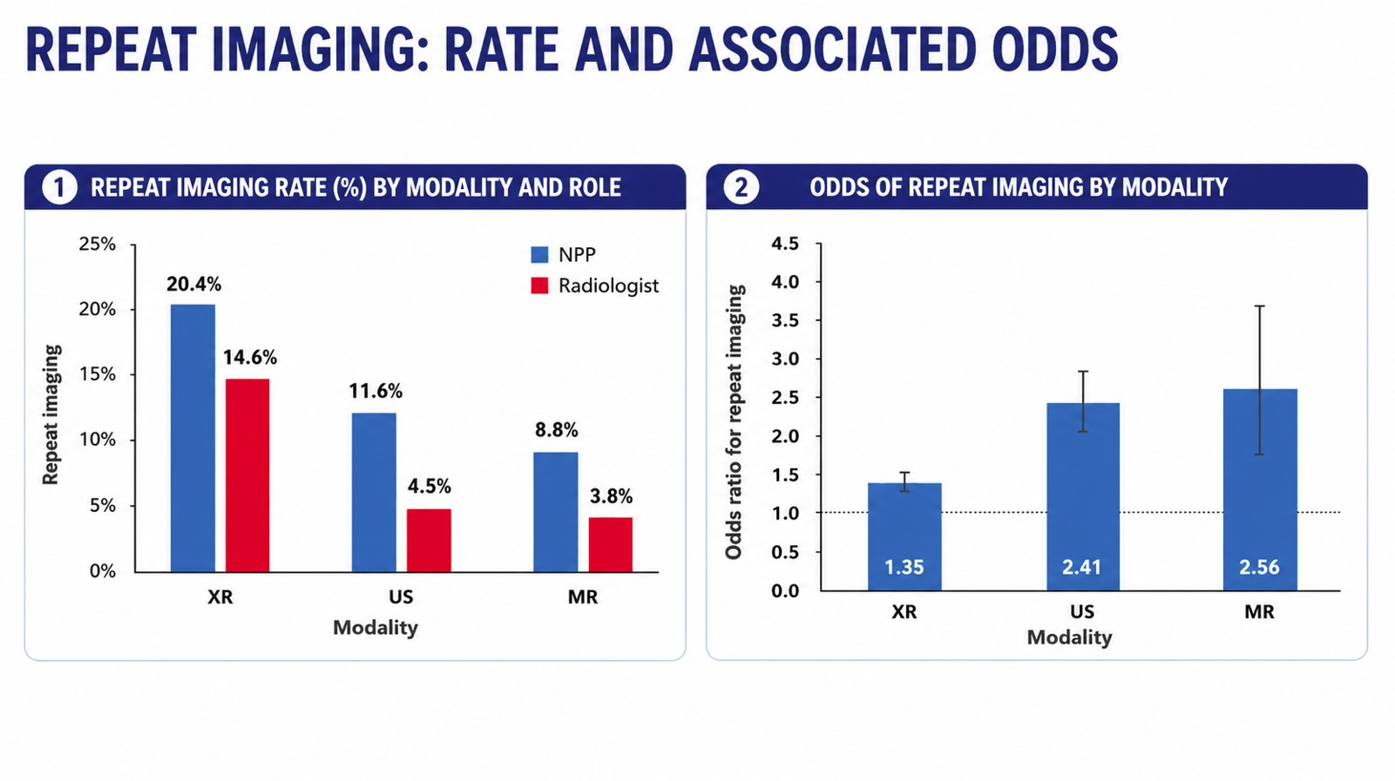
Source: Repeat Imaging Rates for Office-Based Imaging Studies Interpreted by Nonphysician Practitioners Compared With Radiologists. Christensen et al. JACR 2025; 22(11):1357-1365.

Slide 21
Future workforce studies
Economic factors and workforce distribution
  Relative reimbursement/declining Medicare reimbursement
  Insurance mix
  Malpractice environment
Imaging volumes
  Association of radiologist- and self-interpretation rates with ordering patterns
  Low-value imaging rates
  Clinical Decision Support (CDS) systems

Slide 22
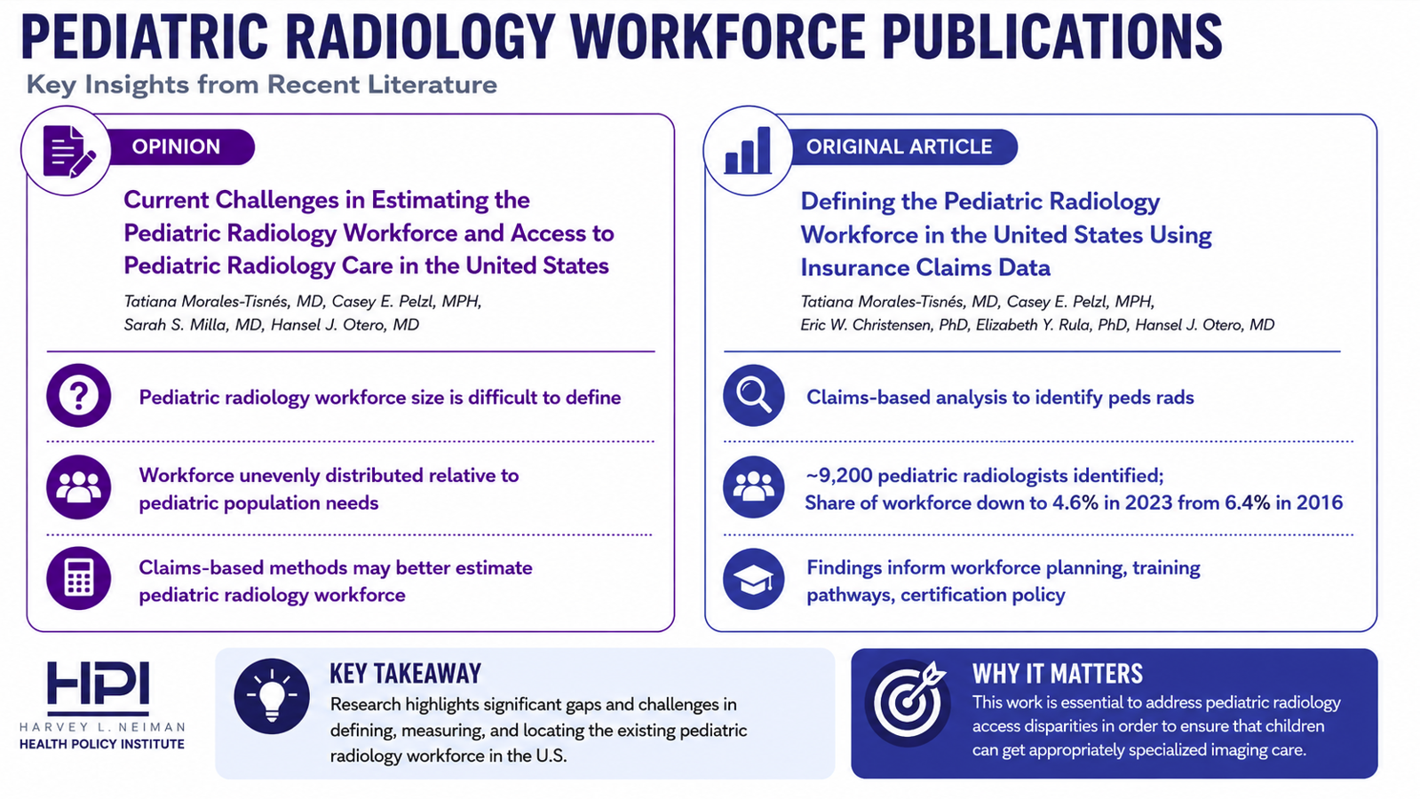

Slide 23
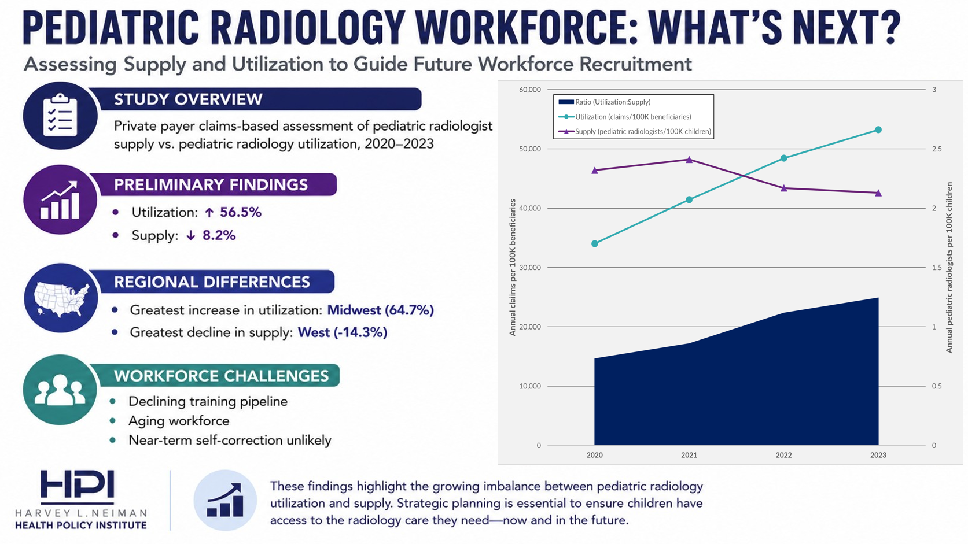
Source: Pelzl CE, Morales-Tisnes T, Christensen EW, Rula EY, Otero HJ. (2026, June 1-5). Geographic Distribution of the Pediatric Radiology Workforce in the United States Using Private Payer Claims Data. IPR Congress, Boston, MA, United States.

Slide 24
The Impact of Radiology on Population Health
Casey Pelzl and Allie Drake

Slide 25
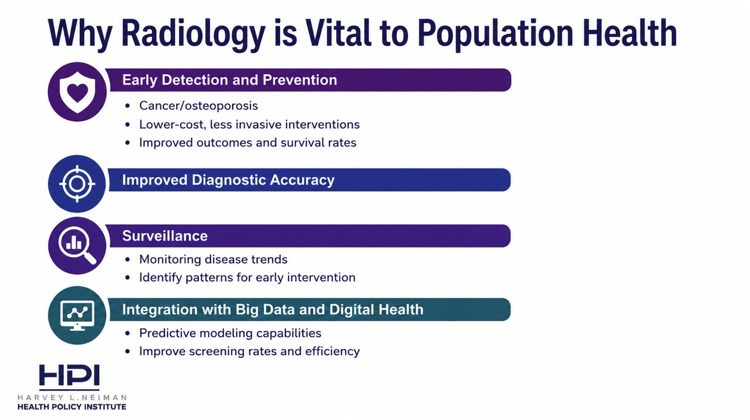

Slide 26
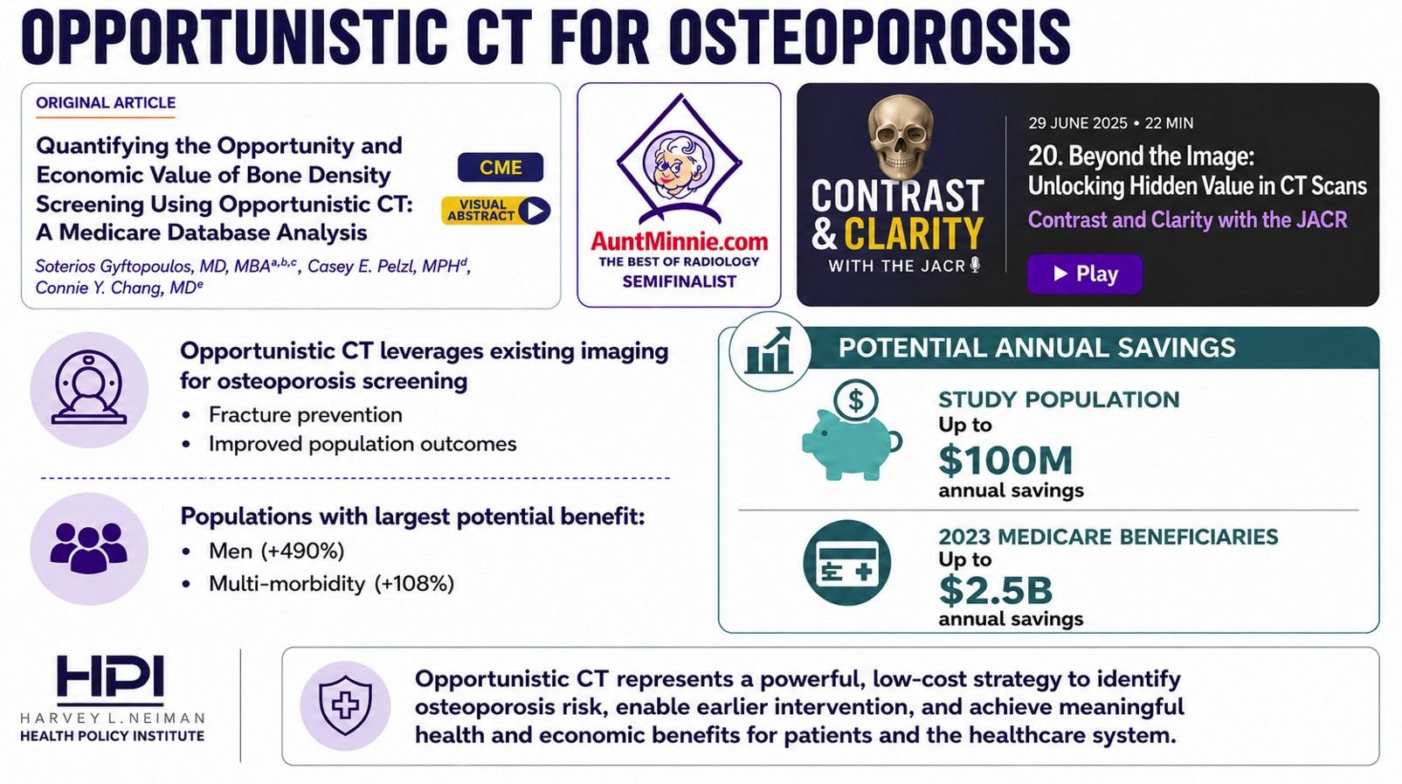

Slide 27
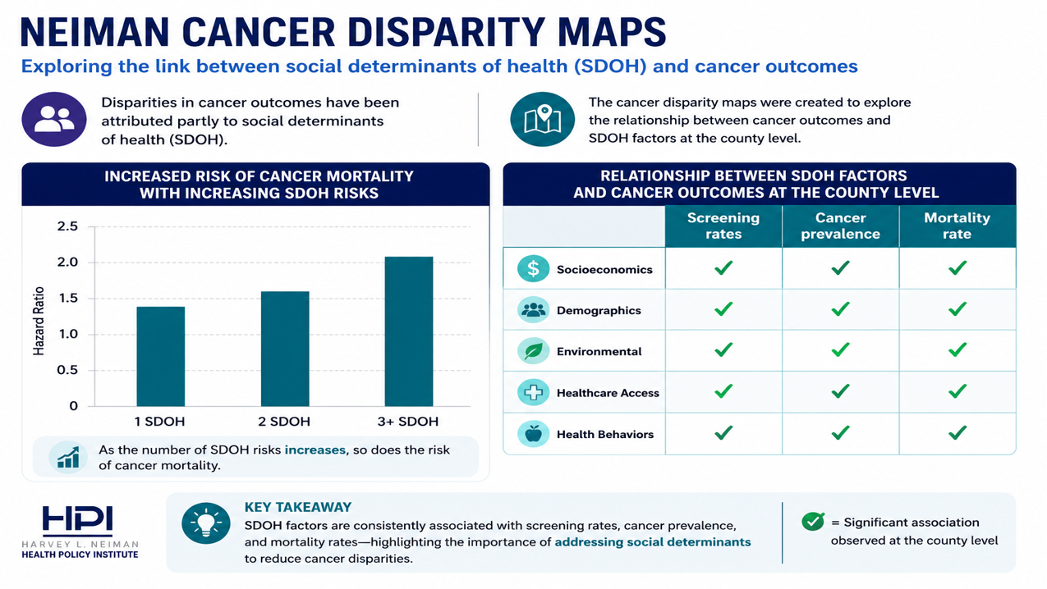
Link to maps: https://www.neimanhpi.org/cec-main-page/

Slide 28
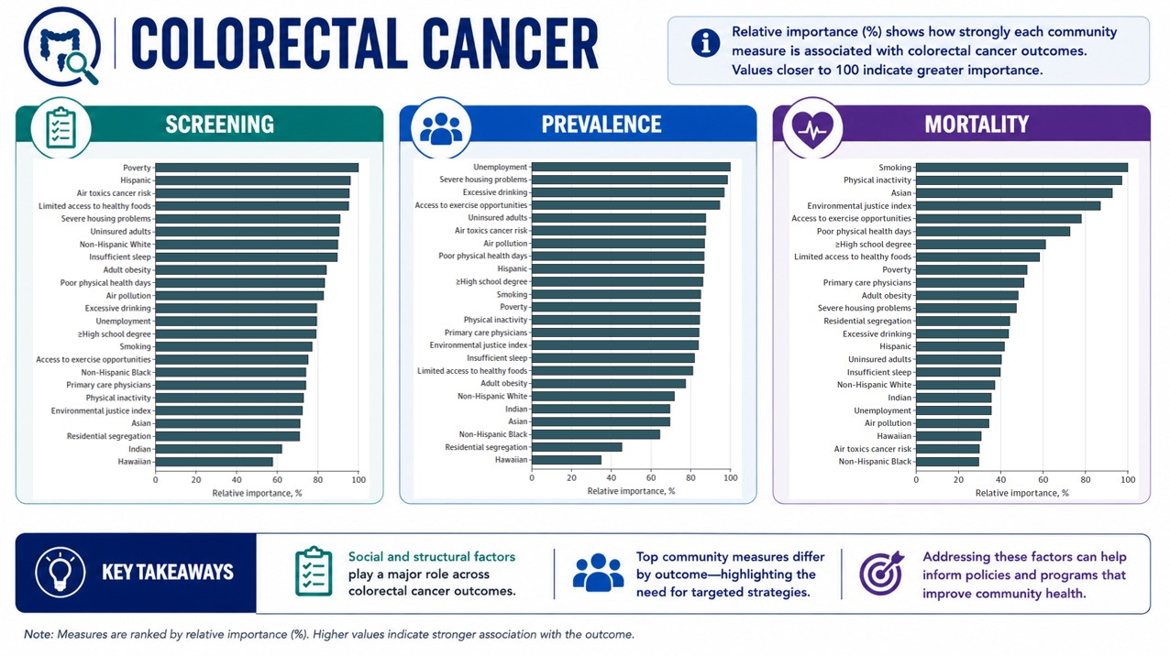
Source: Drake AR, Christensen EW, Ochoa AC, Small W, Scott J, Rula EY. Community Factors and County-Level Cancer Screening, Prevalence, and Mortality. JAMA Netw Open. 2025;8(10):e2537690. doi:10.1001/jamanetworkopen.2025.37690.

Slide 29
How Radiology Fits Into Value Based Payment Models
Yoonie Chung

Slide 30
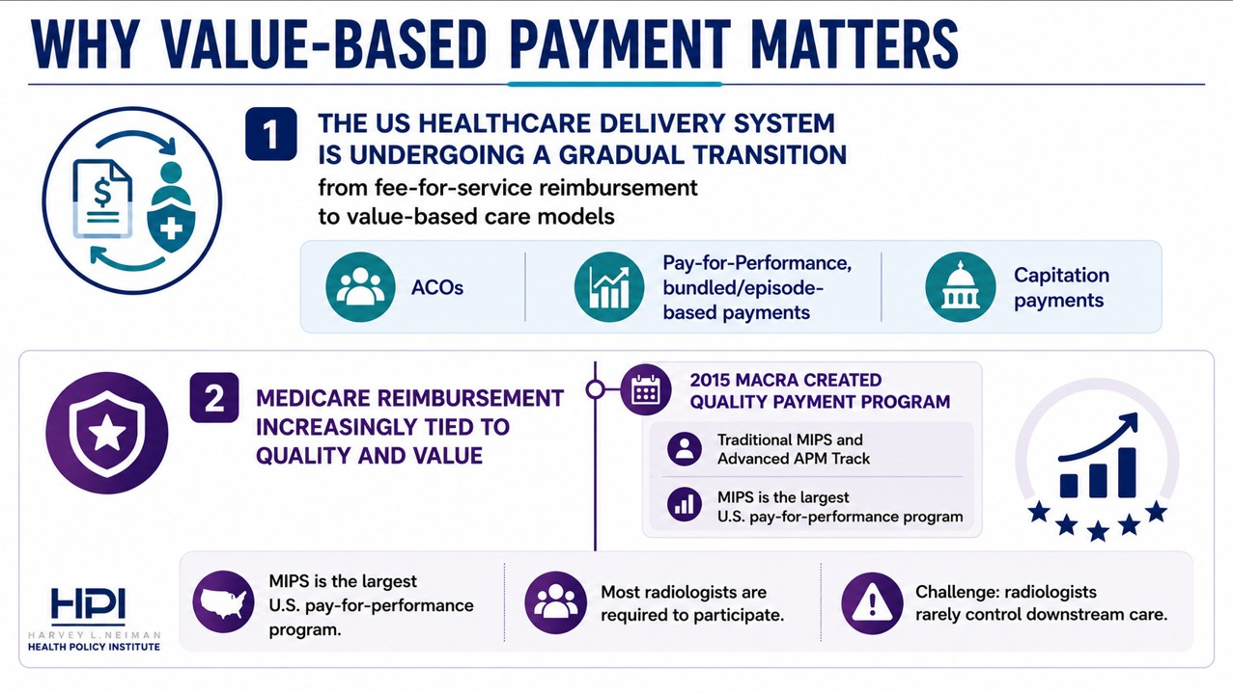

Slide 31
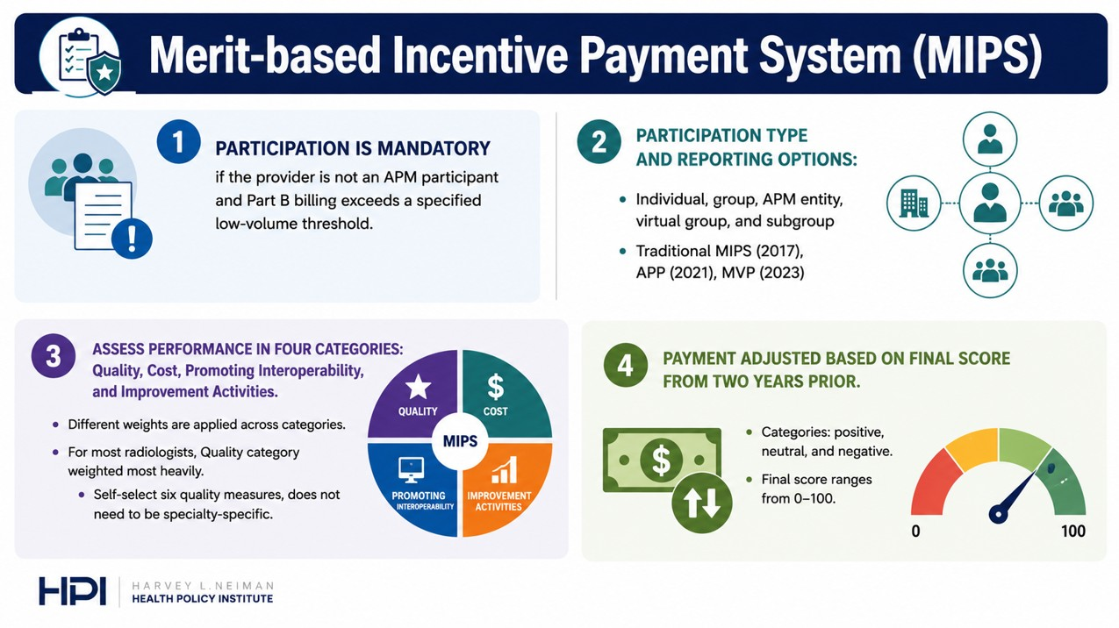
Notes:
Quality – clinical care measures (e.g., outcomes, preventive care)
Cost – Medicare spending and efficiency of care
Improvement Activities (IA) – care coordination, patient engagement, and practice improvement efforts
Promoting Interoperability (PI) – electronic health record (EHR) use and health information exchange

Slide 32
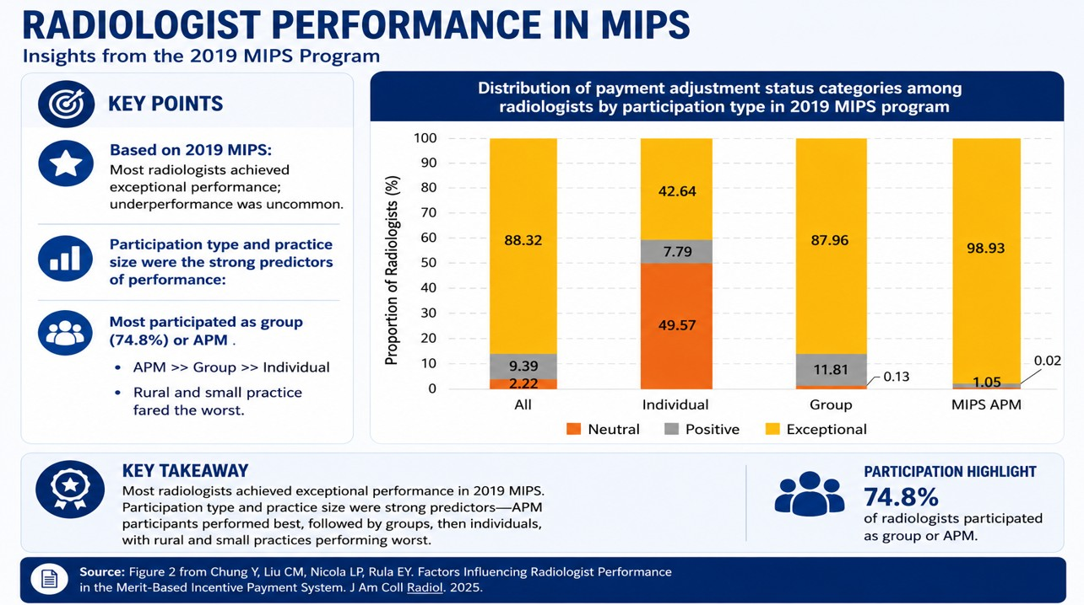

Slide 33
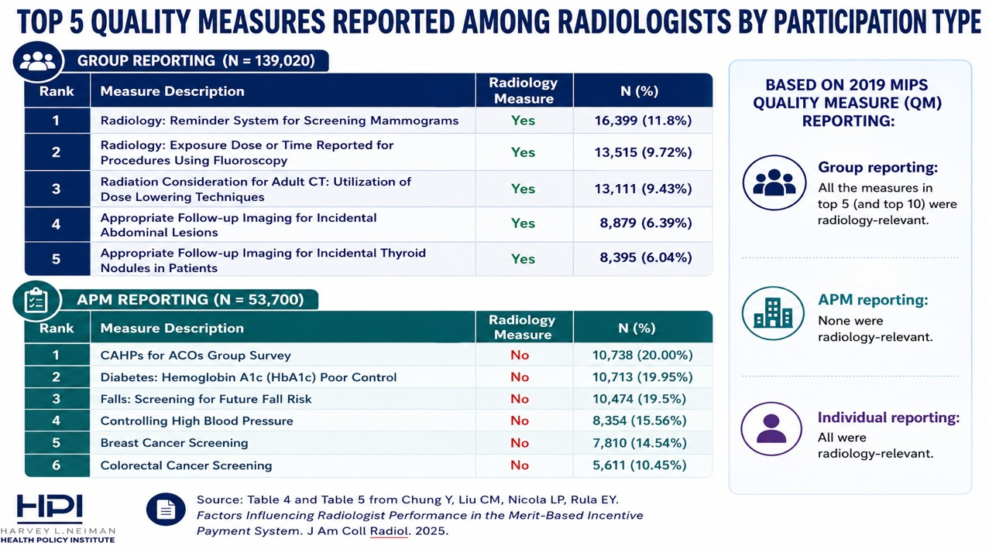

Slide 34
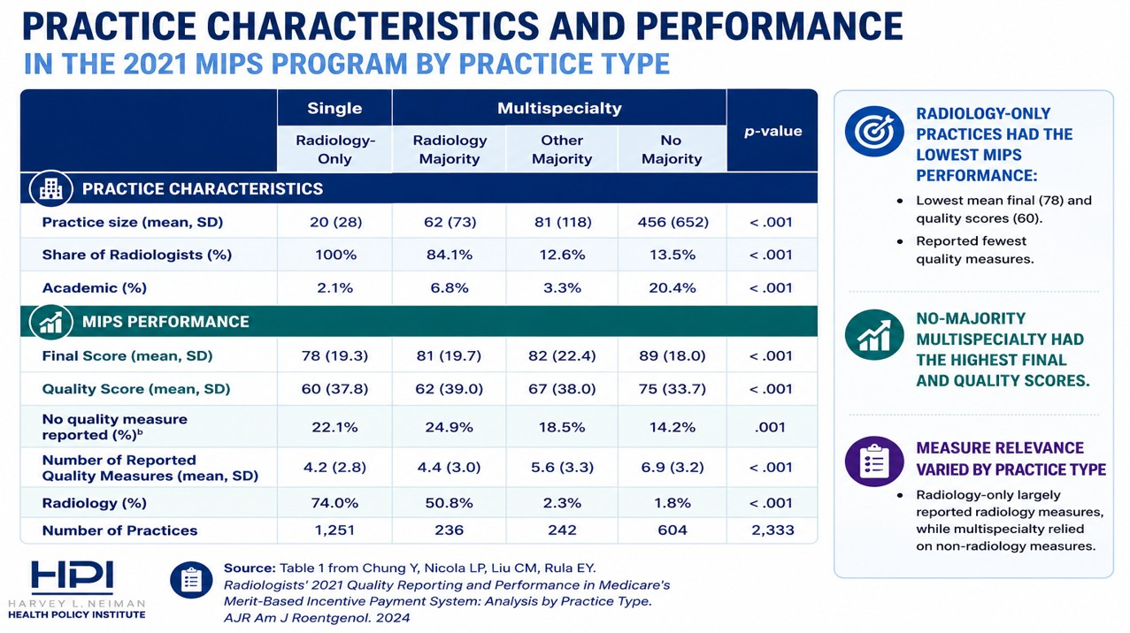

Slide 35
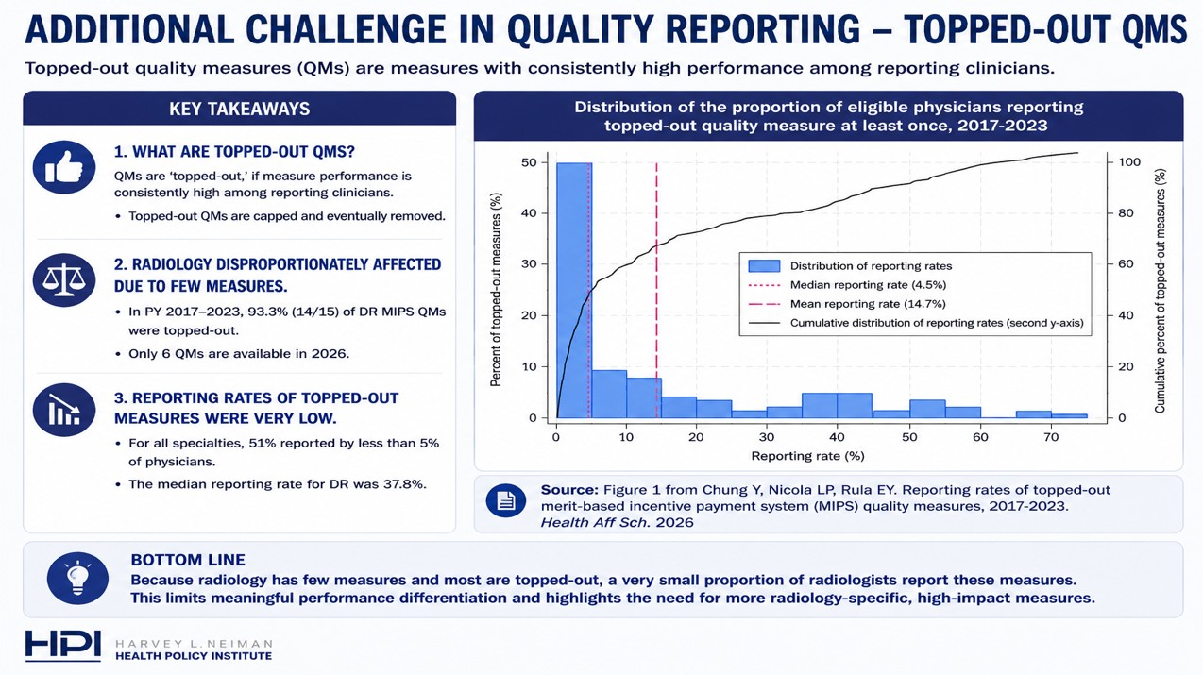

Slide 36
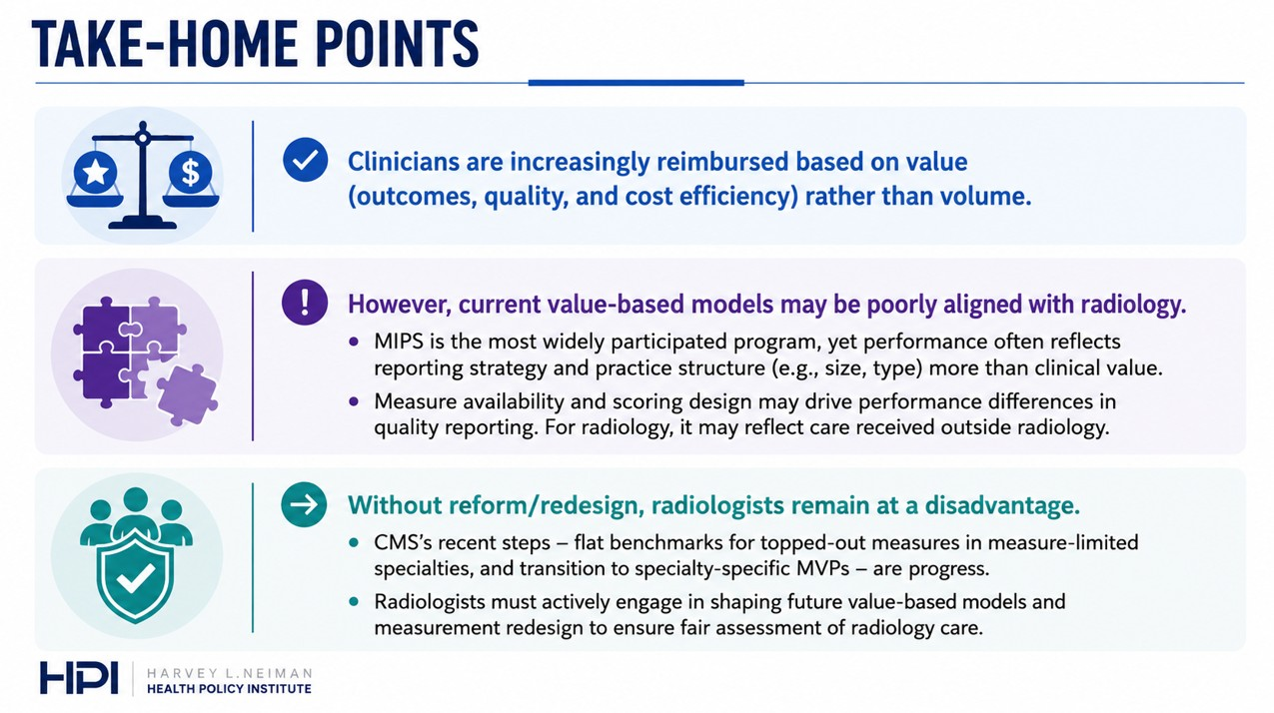

Slide 37
Interventional Radiology
Mikki Waid

Slide 38
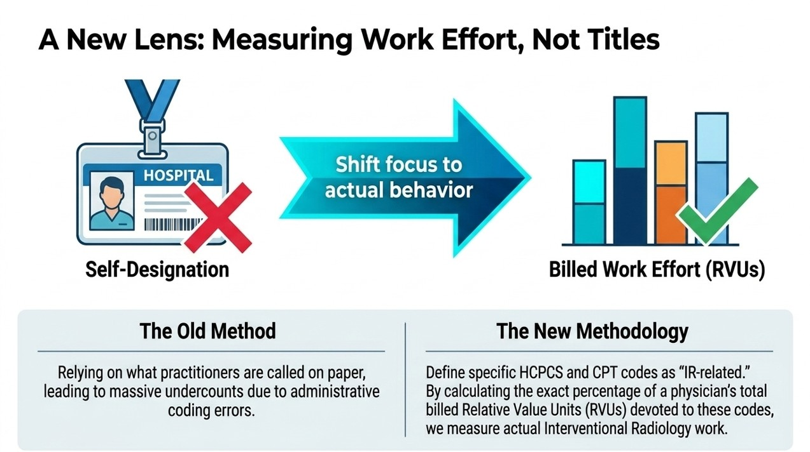

Slide 39
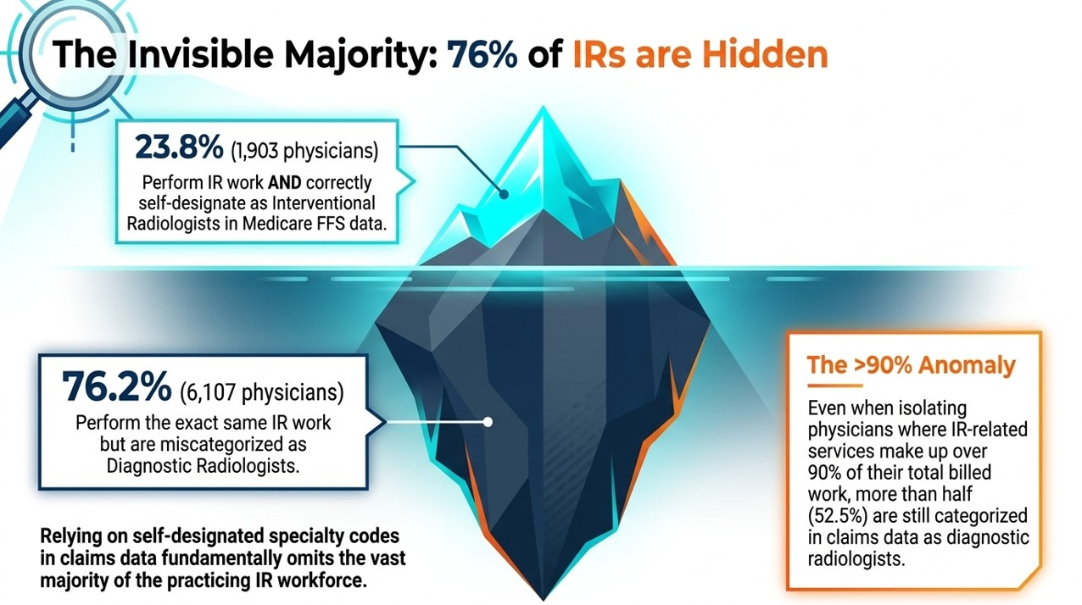
Source: Waid, M. D., Rula, E. Y., Hawkins, C. M., Findeiss, L., & Liu, R. (2024). A Claims-Based Method for Identification and Characterization of Practicing Interventional Radiologists. JVIR, 35(6), 909-917.e5.

Slide 40


Slide 41
References
Slides 11-12: Projected US Imaging Utilization, 2025 to 2055. Eric Christensen et al. J Am Coll Radiol 2025;22:151-158.
Slides 13-14: Attrition of the National Radiologist Workforce: Associations With Radiologist and Practice Characteristics. Eric Christensen et al. AJR:226, January 2026
Slides 15-16:Increasing-Yet Varying-Radiologist Workforce Attrition Across Subspecialties. Eric Christensen et al. Am J Roentgenol. 2026 Mar 4.
Slides 17-19: Radiologist Turnover in the United States. Jay R. Parikh, MD, Eric Christensen, et al. Journal of the American College of Radiology, 25, S1546-1440(26)00031-1. https://doi.org/10.1016/j.jacr.2026.01.009.

Slide 42
References
Slide 20: Repeat Imaging Rates for Office-Based Imaging Studies Interpreted by Nonphysician Practitioners Compared With Radiologists. Eric Christensen et al. Journal of the American College of Radiology, 22(3).
Slide 22:
  Current Challenges in Estimating the Pediatric Radiology Workforce and Access to Pediatric Radiology Care in the United States. Tatiana Morales-Tisnés, MD,Casey E. Pelzl, MPH et al. J Am Coll Radiol, Volume 22, Issue 7, p780-784, July 2025.
  Defining the Pediatric Radiology Workforce in the United States Using Insurance Claims Data. Tatiana Morales-Tisnés, Casey Pelzl, et al. Journal of the American College of Radiology, 22(11).
Slides 27-28: Drake AR, Christensen EW, Ochoa AC, Small W, Scott J, Rula EY. Community Factors and County-Level Cancer Screening, Prevalence, and Mortality. JAMA Netw Open. 2025;8(10):e2537690. doi:10.1001/jamanetworkopen.2025.37690. Link to maps: https://www.neimanhpi.org/cec-main-page/

Slide 43
References
Slides 32-33: Chung Y, Liu C-M, Nicola LP, Rula EY. Factors Influencing Radiologist Performance in the Merit-Based Incentive Payment System. Journal of the American College of Radiology. 2025.
Slide 34: Chung Y, Nicola LP, Liu CM, Rula EY. Radiologists' 2021 Quality Reporting and Performance in Medicare's Merit-Based Incentive Payment System: Analysis by Practice Type. AJR Am J Roentgenol. 2024.
Slide 35: Chung Y, Nicola LP, Rula EY. Reporting rates of topped-out merit-based incentive payment system (MIPS) quality measures, 2017-2023. Health Aff Sch. 2026.
Slide 39: Waid, M. D., Rula, E. Y., Hawkins, C. M., Findeiss, L., & Liu, R. (2024). A Claims-Based Method for Identification and Characterization of Practicing Interventional Radiologists. Journal of Vascular and Interventional Radiology, 35(6), 909-917.e5.

